Slide 1

Exploratory analysis
Center for Health Data Science

Slide 2
Agenda
Count matrix and normalization
RPKM/FPKM-TPM-DESeq2
Exploratory Analysis
PCA, Pearson correlation,
distance heatmaps
Workflow
Differential Expression Analysis
Comparison between conditions
Functional Analysis
Gene-gene correlation
Networks
GO term

Slide 3
Exploratory Analysis. Data transformations
Useful to check samples
Replicates with same condition should cluster together (most similar)
Distribution of gene count values is very skewed!
This is a negative binomial distribution
This will ruin most correlation/distances

Slide 4
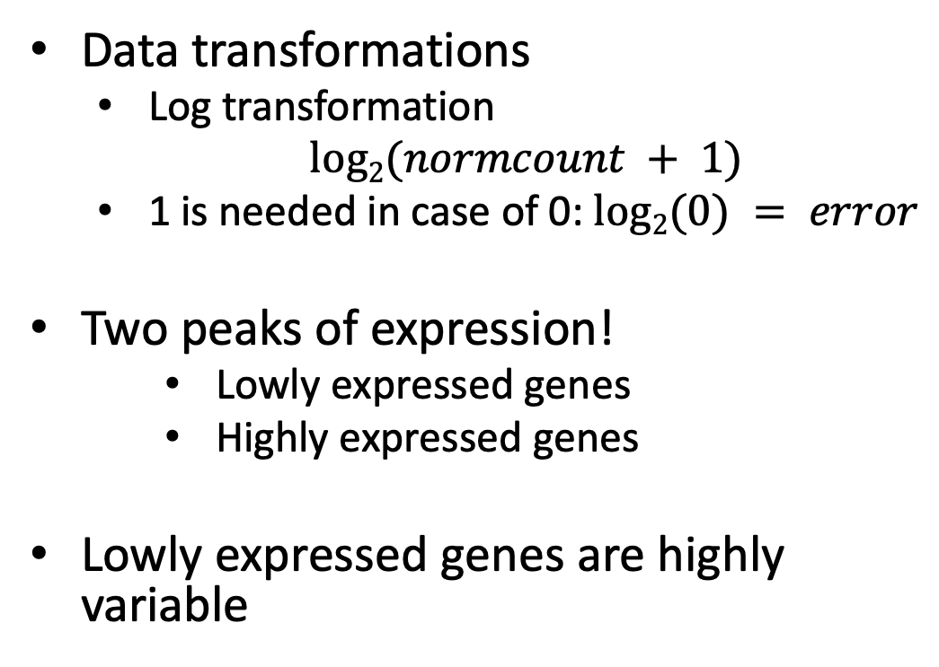
Exploratory Analysis. Rlog or VST
Data transformations
Log transformation
$log2(normcount + 1)$
1 is needed in case of 0: $log2(0) = error$
Two peaks of expression!
Lowly expressed genes
Highly expressed genes
Lowly expressed genes are highly variable
log2(norm counts +1)

Slide 5
Exploratory Analysis. Rlog or VST
Regularized logarithm (rlog) or Variance Stabilizing Transformation (vst)
Avoid high variance in when gene count is very low
Use now log2(count + n). ”n” is estimated by rlog or vst
vst
Log2(count + 1) Standard Deviation
VST Standard Deviation

Slide 6
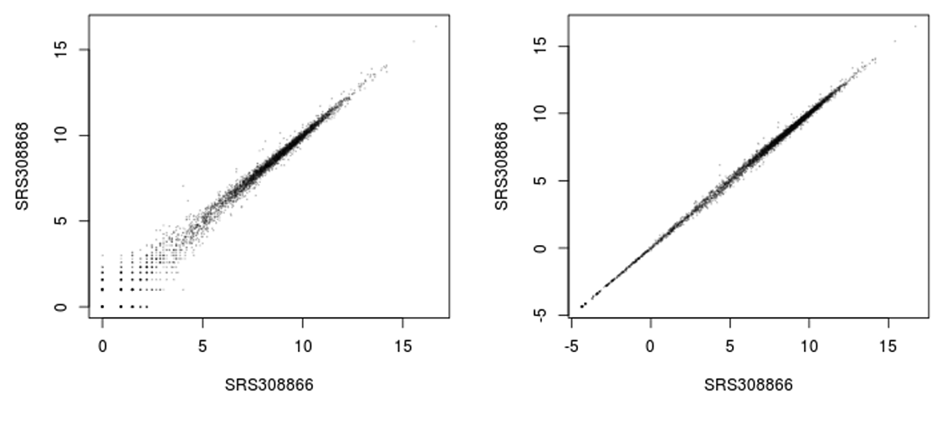
Exploratory Analysis. Rlog or VST
Regularized logarithm (rlog) or Variance Stabilizing Transformation (vst)
Avoid high variance in when gene count is very low
Use now log2(count + n). ”n” is estimated by rlog or vst
Log2 transformation
Rlog transformation

Slide 7
Exploratory Analysis. Visualizations
rlog or vst are not used for Differential Expression Analysis (DEA)!
However, now we can compare our samples with a PCA or heatmaps
Principal Component Analysis (PCA)
Sample
distances

Slide 8
Exploratory Analysis. PCA
Principal Component Analysis
Visualize variation dataset of high dimensionality
Samples are observations (o), genes are dimensions (d)
We can only interpret 2 or 3 dimensions
y
gene | Norm sampleA | Norm sampleB | o = 100
EF2A | 1145.39 | 1176.62 | …
ACBD1 | 16.92 | 16.88 | …
d = 20000 | … | … | …
x
z

Slide 9
Exploratory Analysis. PCA
Variation of genes is collapsed into Principal Components (PCs)
PC1
1st maximum variance
Little variation
geneB
geneA Expression
PC1
Highly variable
PC2
2nd maximum variance
PC2
geneB Expression
geneA

Slide 10
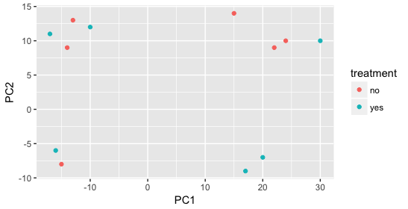
Exploratory Analysis. PCA
Variation of genes is collapsed into Principal Components (PCs)
Samples with similar gene expression related to PCs will be together
First PCs contain most variation
Usually PC1-PC4 are used
We need metadata to understand
source of variation

Slide 11
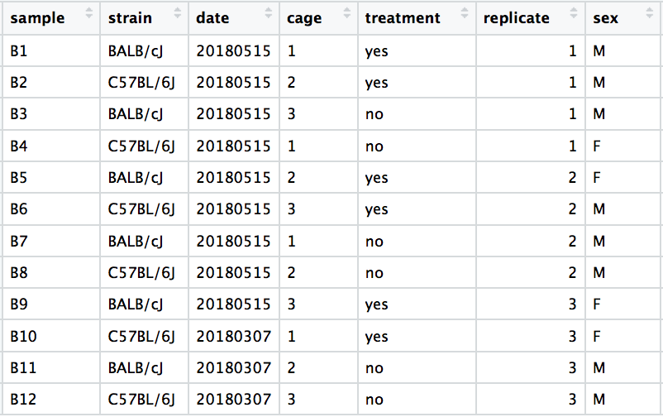
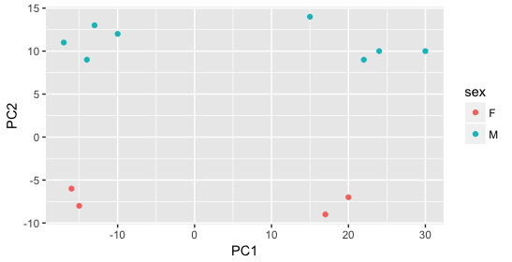
Exploratory Analysis. PCA
We need metadata to understand

Slide 12
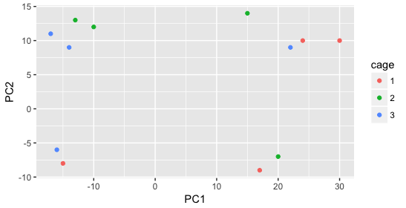
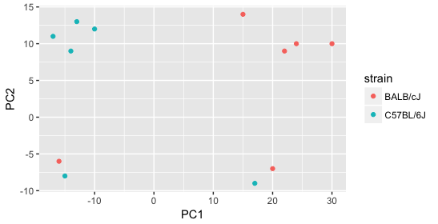
Exploratory Analysis. PCA
We need metadata to understand

Slide 13
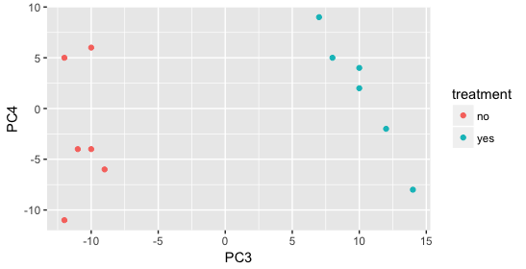
Exploratory Analysis. PCA
We need metadata to understand

Slide 14
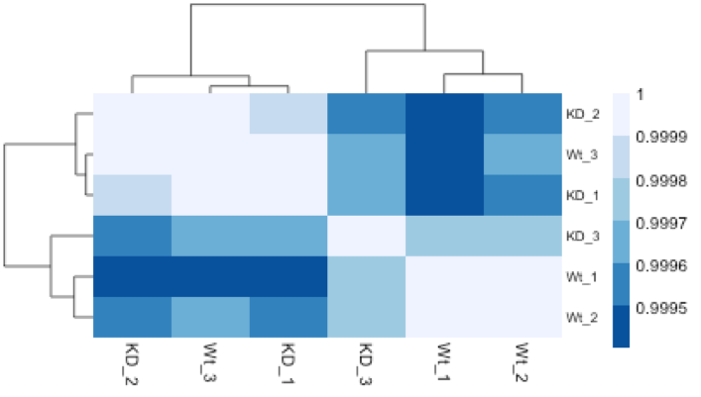
Exploratory analysis. Heatmaps
Hierarchical clustering and heatmaps
Cluster/group samples together
Can use:
Gene expression distances
Correlations
Heatmap and a dendrogram
Complements PCA

Slide 15
Exploratory Analysis. Visualizations
Examples of when something is not right:

